Slide 1
AWS Cloud Intro
What is AWS Cloud?
AWS (Amazon Web Services) is a cloud computing platform.
The first product (S3) was released in 2006.
AWS has grown a lot since then in both size and product range.
It is, to date, the largest cloud provider in the world.

Slide 2
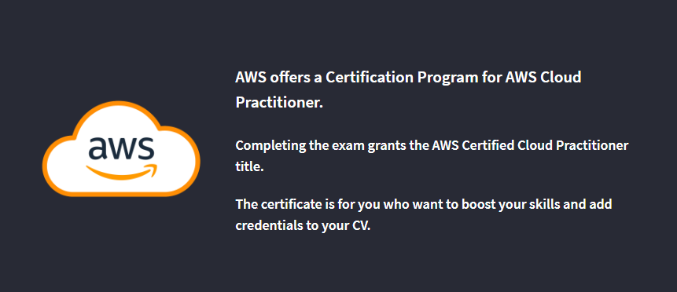
AWS Certified Cloud Practitioner

Slide 3
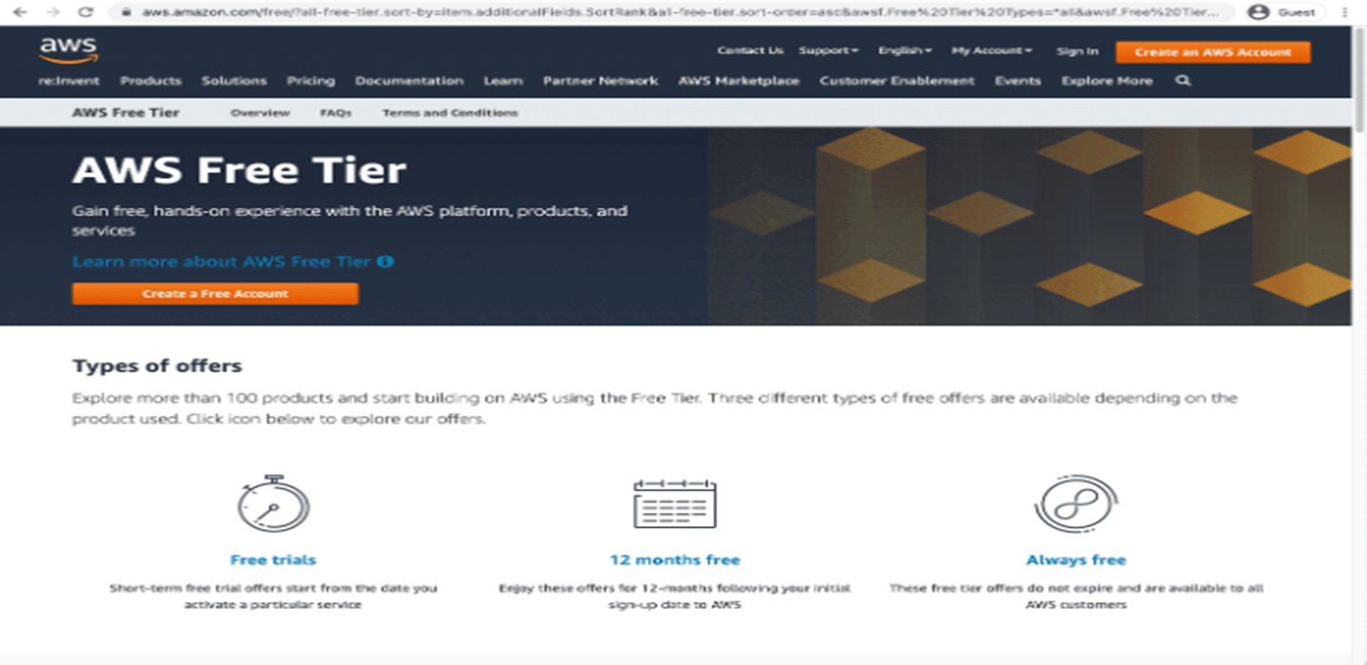
Free AWS Account

Slide 4
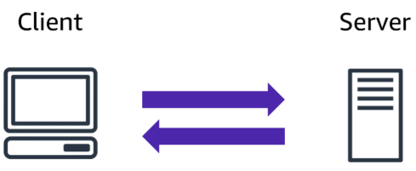
AWS Cloud Computing
The Client-Server Model
The Client-Server model is about a client that interacts and makes requests to a computer server.
A client is the way that the person interact with the server.

Slide 5


Slide 6
Coffee shop connections
we used the example of a customer ordering a cup of coffee to help explain how a client-server model works.
As this training progresses, you will continue to see comparisons between elements of a coffee shop and cloud computing functions. For example, you will explore how different AWS compute instances are kind of like the different types of coffee machines in a coffee shop. Each machine is workload-specific to better serve its customers.
The purpose of the coffee shop analogy is to reduce complexity of cloud concepts and take your cloud knowledge from theoretical concept to practical experience.

Slide 7
What is Cloud Computing?
Cloud computing is a computing service made available over the internet.
Cloud computing is a pay-as-you-go model for delivering IT resources.
You pay only for what you use.
Deployment Models
There are three different kinds of deployment models:
Cloud-based
On-premises
Hybrid
The models are different ways of accessing compute services - over the internet, locally, or in a combination.

Slide 8
Cloud-Based Deployment
Everything runs in the cloud.
This model allows you to build new applications or move existing ones to the cloud.
There are different levels of services ranging from low to high.
The level of service has different requirements on your management, architecting, and infrastructure.
For example, a company might create an application consisting of virtual servers, databases, and networking components entirely based in the cloud.

Slide 9
On-Premises Deployment
Deploy resources by using virtualization and resource management tools.
On-Premises Deployment is also known as private cloud deployment.
For example, you might have applications that run on technology that is fully kept in your on-premises data center.
Though this model is much like legacy IT infrastructure, its application management and virtualization technologies make it more effective.

Slide 10
Hybrid Deployment
In a hybrid deployment, you connect cloud resources to an on-premises infrastructure.
This approach is relevant in many situations.
For example, you are working with sensitive data or are under specific government regulations.

Slide 11
Why Choose Cloud Computing?
There are many reasons for going with the cloud.
Cloud computing enables benefits such as:
Trade fixed expense for variable expense
Benefit from massive economies of scale
Stop guessing capacity
Increase speed and agility
Stop spending money to run and maintain data centers
Go global in minutes

Slide 12
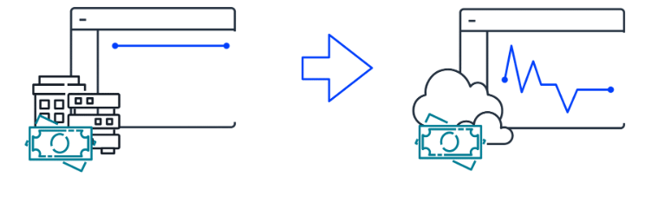
Trade fixed expense for variable expense
By using the AWS Cloud, businesses can transition from fixed investments to variable costs. With variable costs, customer expenses are better aligned with actual usage, thus creating more financial flexibility.

Slide 13
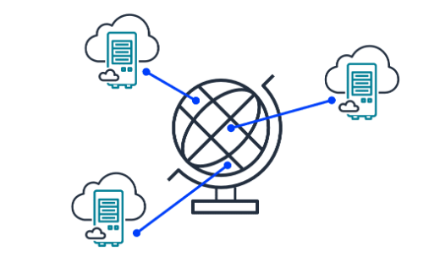
Benefit from massive economies of scale
Like buying a product in bulk can result in lower prices per unit, the vast global infrastructure of AWS can result in lower costs for customers. This means that AWS can be used by many organizations, from small startups to major corporations. Businesses big and small can access advanced technologies that were previously only accessible to large enterprises.

Slide 14
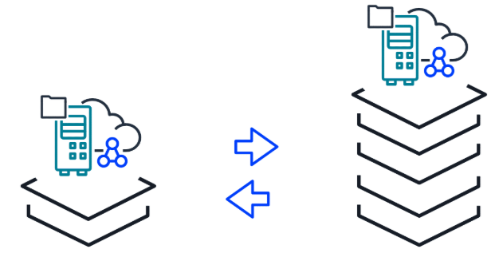
Stop guessing capacity
Customers can dynamically scale AWS Cloud resources up or down based on real-time demand. This means businesses can achieve optimal performance without provisioning more or less infrastructure than they need.

Slide 15
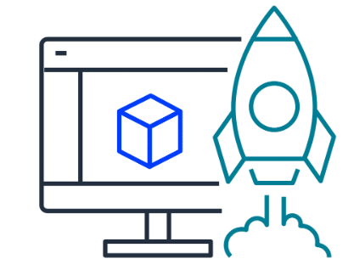
Increase speed and agility
With the cloud, businesses can rapidly deploy applications and services, accelerating time to market and facilitating quicker responses to changing business needs and market conditions

Slide 16

Stop spending money to run and maintain data centers
The AWS Cloud eliminates the need for businesses to invest in physical data centers. This means customers aren't required to spend time and money on utilities and ongoing maintenance. With AWS taking care of the physical infrastructure of the cloud, customer resources can be reallocated to more strategic initiatives.

Slide 17
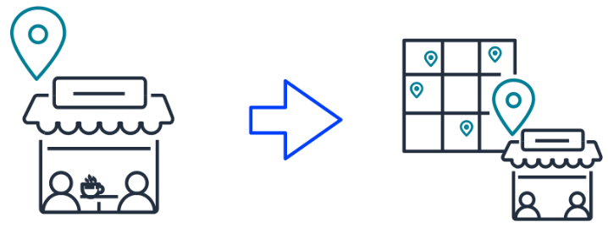
Go global in minutes
Businesses don't need to set up their own infrastructure to expand internationally. AWS provides a robust global infrastructure that customers can use to deploy applications and services across multiple areas in minutes.

Slide 18
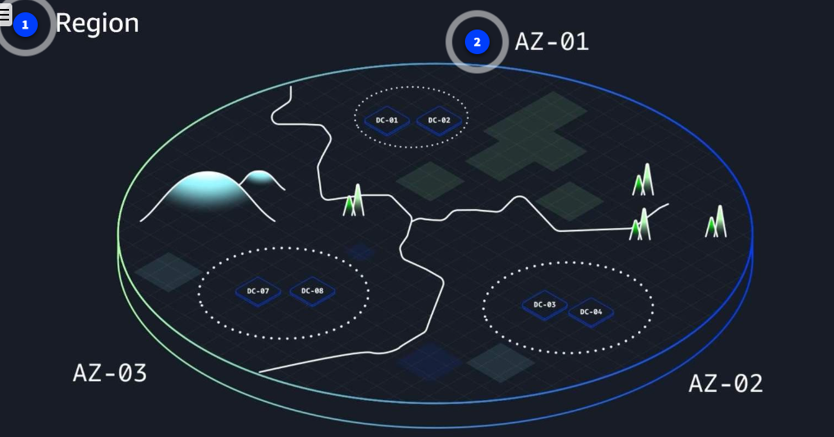
AWS Regions and Availability Zones
AWS Global Infrastructure consists of physical locations around the world that contain groups of data centers. To learn more about the design of AWS Regions and Availability Zones, choose each of the following two numbered markers.

Slide 19
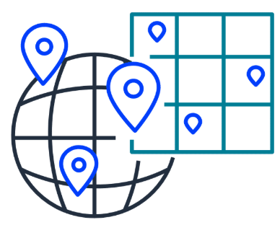
Achieving high availability with AWS Global Infrastructure
AWS infrastructure is designed with high availability and fault tolerance in mind. Availability Zones (AZs) are configured as isolated resources, and they are each equipped with independent power, networking, and connectivity.
It's recommended to distribute your resources across multiple AZs. That way, if one AZ encounters an outage, your business applications will continue to operate without interruption. With this approach of redundancy and resource isolation, AWS customers can achieve the benefits of high availability and fault tolerance.

Slide 20
Components of the AWS Shared Responsibility Model
The AWS Shared Responsibility Model is a concept designed to help AWS and customers work together to create a secure, functional cloud environment.

Slide 21
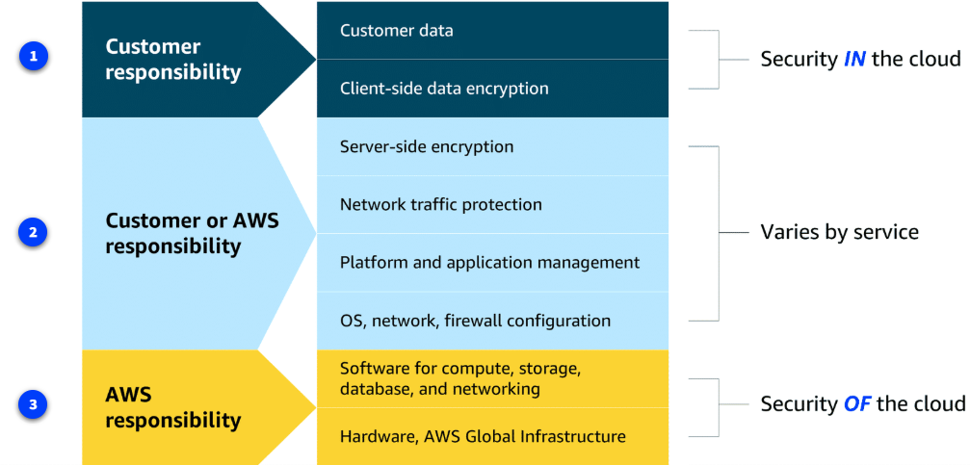
Components of the AWS Shared Responsibility Model

Slide 22
Introduction to Amazon EC2
Amazon EC2 is more flexible, cost-effective, and faster than managing on-premises servers. It offers on-demand compute capacity that can be quickly launched, scaled, and terminated, with costs based only on active usage.
The flexibility of Amazon EC2 allows for faster development and deployment of applications. You can launch as many or as few virtual servers as needed and configure security, networking, and storage. You can also scale resources up or down based on usage, such as handling high traffic or compute-heavy tasks.

Slide 23

Comparing on-premises and cloud resources
When designing infrastructure for your business, selecting the right resources can significantly affect your efficiency, flexibility, and overall costs. Review the key differences between on-premises and cloud resource management.

Slide 24
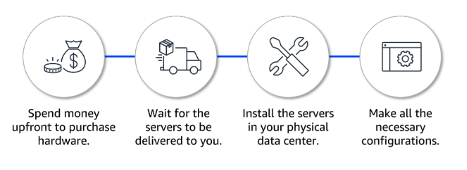
Challenges of on-premises resources
Imagine that you're responsible for designing your company's infrastructure to support new websites. With traditional on-premises resources, you must purchase hardware upfront, wait for delivery, and handle installation and configuration. This process is time-consuming, costly, and inflexible because you're locked into a specific capacity that might not align with changing demands.

Slide 25
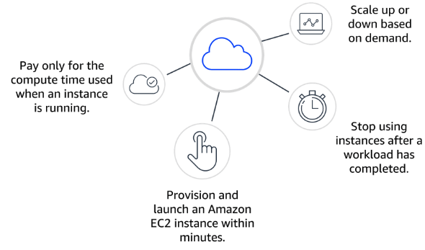
Benefits of using Cloud Resources
In contrast, with Amazon EC2, you can quickly launch, scale, and stop instances based on your needs without the delays and upfront costs associated with traditional on-premises resources.

Slide 26
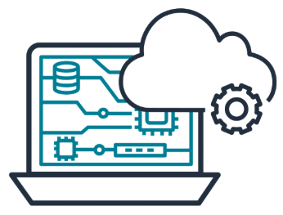
How Amazon EC2 works
You’ve learned that AWS manages complex infrastructure, offering on-demand compute capacity that’s available whenever you need it. You can request EC2 instances and have them ready to use within minutes. But how do you actually get started?

Slide 27
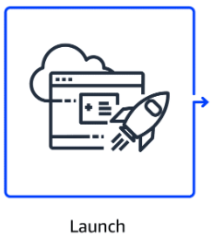
Step1:Launch an instance
When launching an EC2 instance, you start by selecting an Amazon Machine Image (AMI), which defines the operating system and might include additional software. You also choose an instance type, which determines the underlying hardware resources, such as CPU, memory, and network performance.

Slide 28
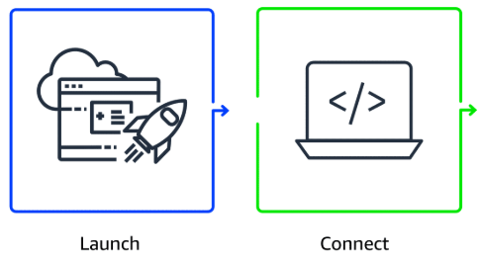
Step2: Connect to the instance
You can connect to an EC2 instance in various ways. Applications can interact with services running on the instance over the network.
Users or administrators can connect using SSH for Linux instances or Remote Desktop Protocol (RDP) for Windows instances. Alternatively, AWS services like AWS Systems Manager offer a secure and simplified method for accessing instances.

Slide 29
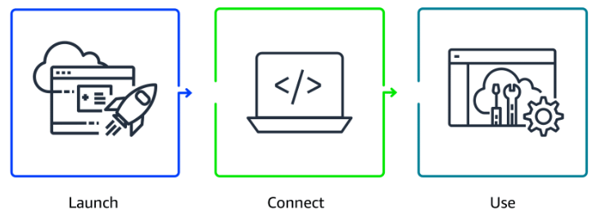
Step3:Use the instance
After you are connected to the instance, you can begin using it to run commands, install software, add storage, organize files, and perform other tasks.

Slide 30
Amazon EC2 Instance Types
Amazon EC2 offers a broad range of instance types, each tailored to meet specific use case requirements. These instances come with varying combinations of CPU, memory, storage, and networking capabilities, so you can choose the right mix of resources to optimize performance for your applications.
Whether you're running a simple web service or complex data processing tasks, Amazon EC2 provides the flexibility to select the ideal instance type for your needs.

Slide 31

Amazon EC2 Instance Types
1.General purpose:
General-purpose instances provide a balanced mix of compute, memory, and networking resources. They are ideal for diverse workloads, like web services, code repositories, and when workload performance is uncertain.

Slide 32
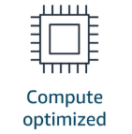
Amazon EC2 Instance Types
2.Compute optimized
Compute optimized instances are ideal for compute-intensive tasks, such as gaming servers, high performance computing (HPC), machine learning, and scientific modeling.

Slide 33
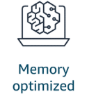
Amazon EC2 Instance Types
Memory optimized
Memory optimized instances are used for memory-intensive tasks like processing large datasets, data analytics, and databases. They provide fast performance for memory-heavy workloads.

Slide 34
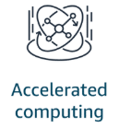
Amazon EC2 Instance Types
Accelerated computing
Accelerated computing instances use hardware accelerators, like graphics processing units (GPUs), to efficiently handle tasks, such as floating-point calculations, graphics processing, and machine learning.

Slide 35
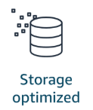
Amazon EC2 Instance Types
Storage optimized
Storage optimized instances are designed for workloads that require high performance for locally stored data, such as large databases, data warehousing, and I/O-intensive applications.

Slide 36
How to Provision AWS Resources
In AWS, tasks such as launching an EC2 instance, stopping an instance, or modifying instance settings are done through API requests. APIs provide predefined methods to interact with, manage, and configure AWS resources efficiently. In this lesson, you will learn about the three main ways to call AWS APIs.

Slide 37
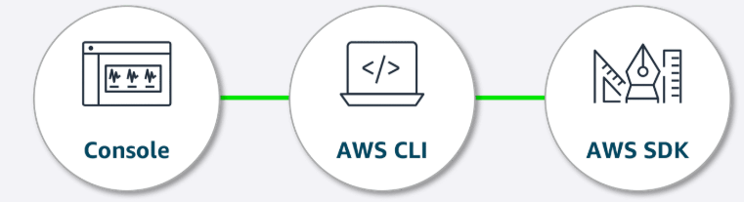
Interacting with AWS services
All interactions with services are powered by APIs. You can access these APIs through three primary methods: the AWS Management Console, the AWS CLI, or the AWS SDK. Let's review these methods.

Slide 38
AWS Management Console
The AWS Management Console is a web interface for managing AWS services, offering quick access to services, search functionality, and simplified workflows. With the mobile app, you monitor resources, view alarms, and check billing, supporting multiple logged-in identities at once.
Good for: Users who prefer a visual, easy-to-use interface for managing and configuring AWS services

Slide 39
AWS CLI
With the AWS CLI, you manage multiple AWS services directly from the command line across Windows, macOS, and Linux. You can automate tasks through scripts, such as launching EC2 instances.
Good for: Advanced users and developers who need to automate tasks, script actions, and manage AWS resources efficiently from the command line

Slide 40
AWS SDK
The AWS SDK simplifies integrating AWS services into your applications by providing APIs for various programming languages. AWS offers documentation and sample code for languages like C++, Java, and .NET to help you get started.
Good for: Developers looking to integrate AWS services into their applications using language-specific APIs

Slide 41
Thank You

